Slide 1
Interview reservation system
By: Bharath Palanisamy, Joseph Mackie, Hishaam Ahamad, and Borjana Velu

Slide 2
Agenda
Summary of the system
High level design and patterns
Network Diagram
Technologies used
Process flows
Demo

Slide 3
Summary
Allowing companies and candidates to agree upon an interview.
Allowing the company and candidates to share their availability.
Allowing integration with Google Calendar.
Canceling or editing an interview.
Reporting the interviews scheduled.

Slide 4
High Level Design and Patterns
Gatekeeper
Handles external requests
Authenticates and Authorizes the User
Forwards request to the internal service
Reporting
Handles reporting requests
Internal Services
Security
Communications
Configuration
Availability
Candidate
Employee
Scheduling
Calendar
Patterns:
Gatekeeper
REST
Database per Service
Pub/Sub

Slide 5
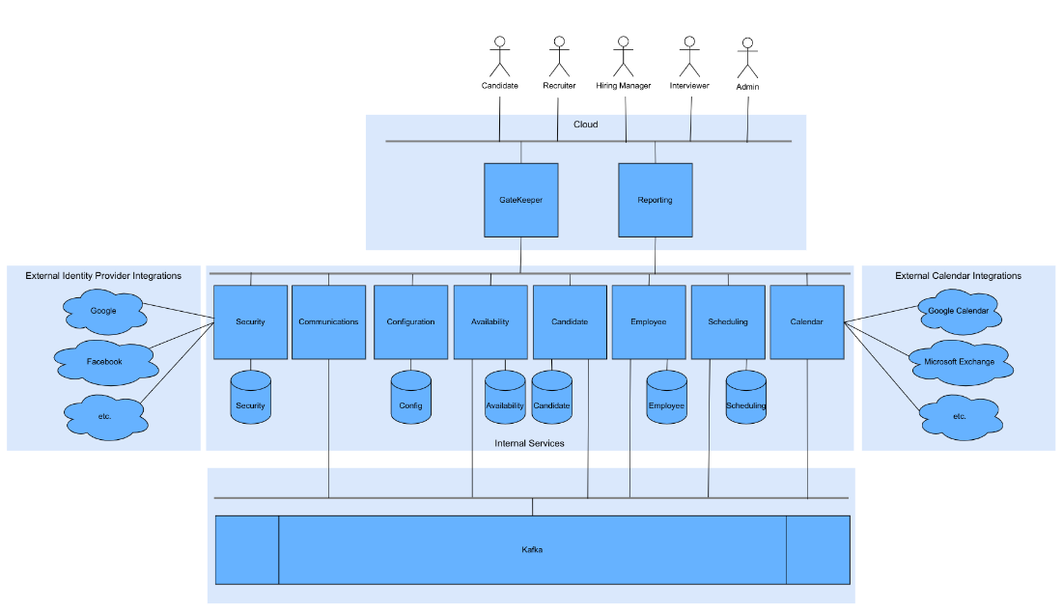

Slide 6
Technologies Used
Web Development
Language: Python
Web Framework: Flask
Authentication Mechanism: JWT Token
Data Development
ORM: SQLAlchemy
Database: Postgresql
Service Integration: Kafka
DevOps
Container Creation: Docker
Container Registry: Docker Hub
Service Orchestration: Kubernetes
Cloud Platform: Okteto
Source Control: Git
Source Control Repository: Github
Build and Deployment Tool: Github Actions

Slide 7
Challenges Faced
Integrating authentication and authorisation with the security service database presented challenges that were overcome by using the ORM.
Understanding the correct properties for the request objects.
The service IP addresses are used to resolve issues faced when sending requests via the FQDN.
Exponential number of connections.

Slide 8
Goals Archived
Improved processes to produce the best results possible given the inputs.
Determine who has the bandwidth for this project by examining the present workflow and outstanding tasks.
Establish due dates for each activity.
Frequently we checked in to make sure the project is on schedule.

Slide 9
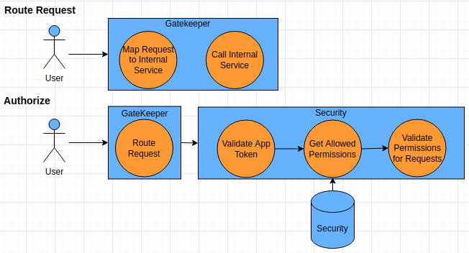
Gatekeeper Service Process Flows

Slide 10
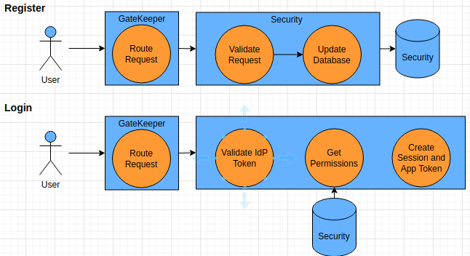
Security Service Process Flows

Slide 11
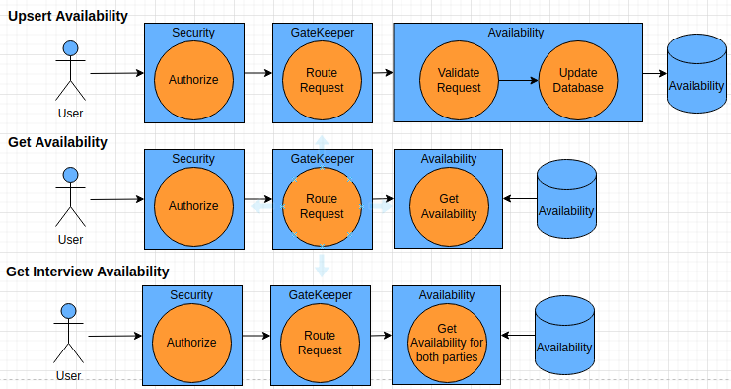
Availability Service Process Flows

Slide 12
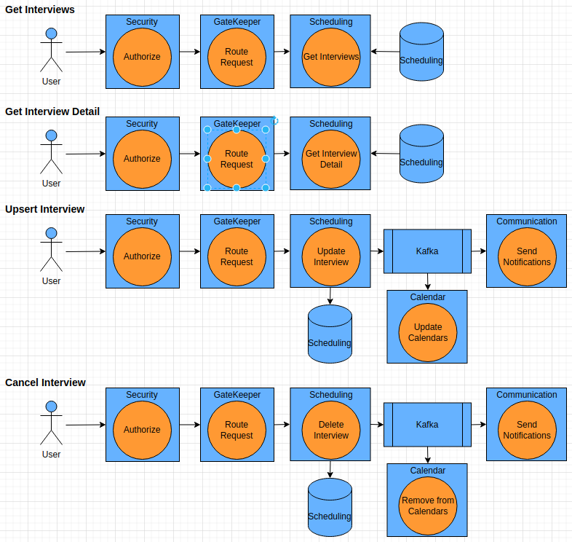
Scheduling Service Process Flows

Slide 13
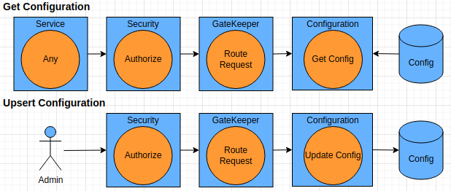
Configuration Service Process Flows

Slide 14
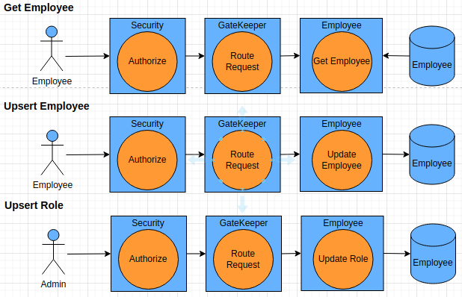
Employee Service Process Flows

Slide 15
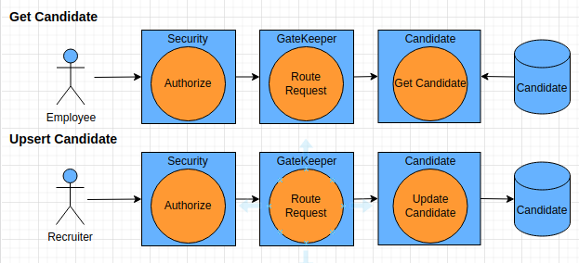
Candidate Service Process Flows

Slide 16
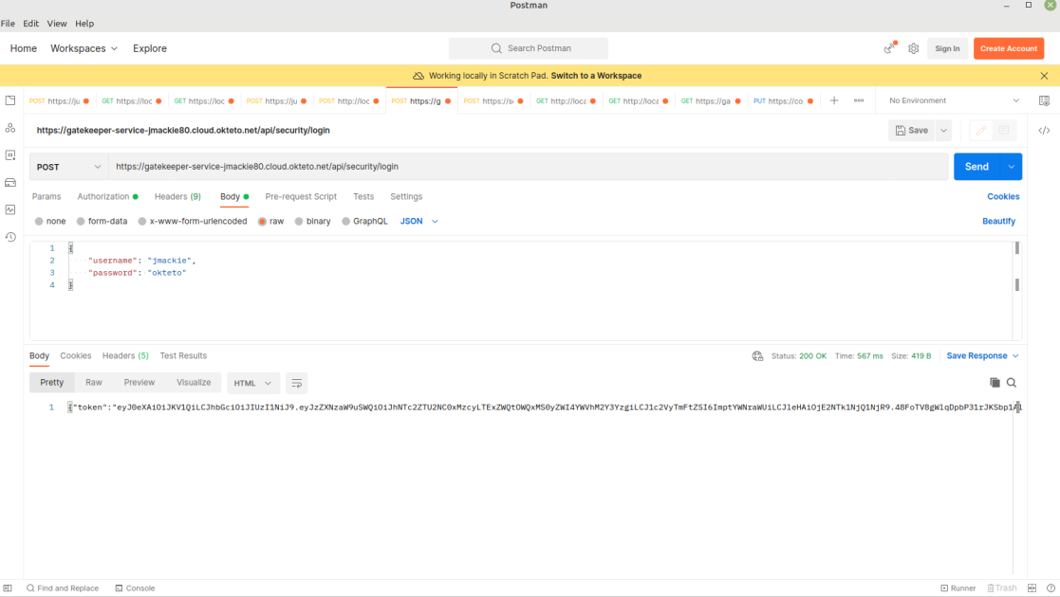
Security - Login

Slide 17
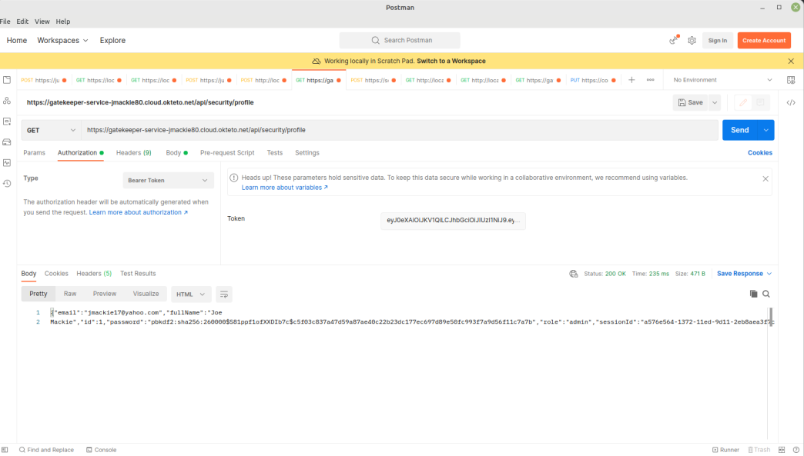
Security -Profile

Slide 18
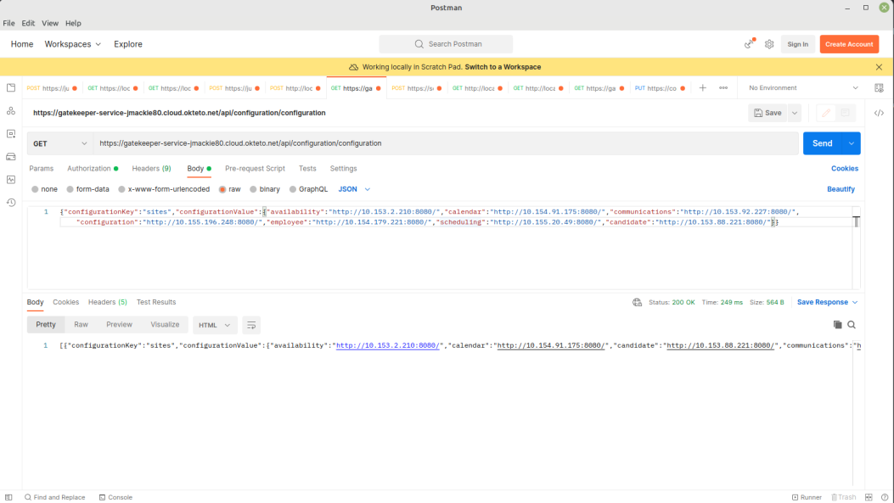
Configuration

Slide 19
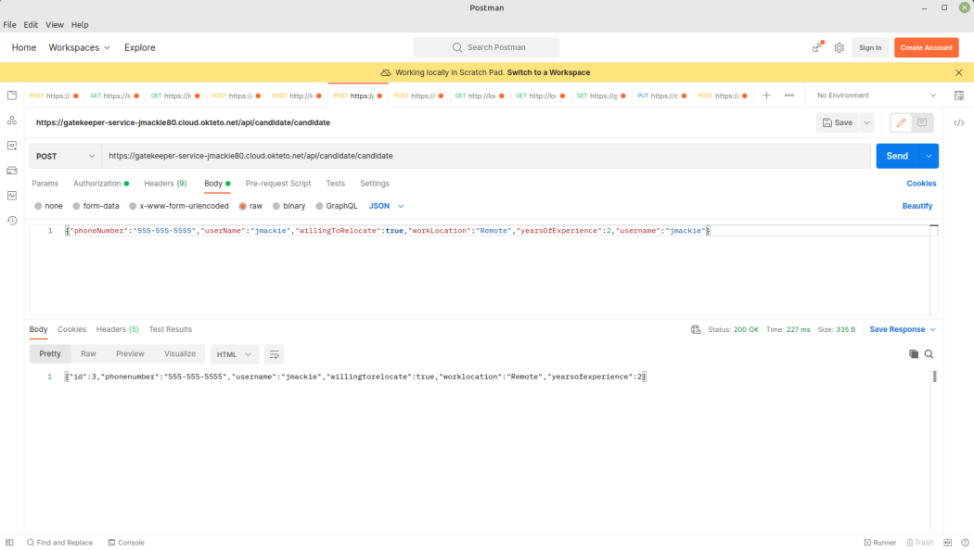
Candidate

Slide 20
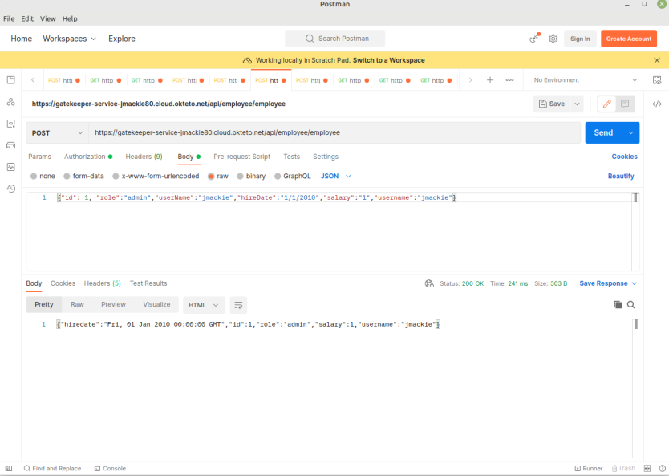
Employee

